Slide 1
Graphs introduction
Examples
Concepts and Terminology
Implementation
Graph Traversals
Notes:
1

Slide 2
Graph
Informally, a graph consists of a non-empty set V of vertices (or nodes), and a set E of edges that connect (pairs of) vertices.
Different types of graphs (undirected, directed, simple, multigraph. . .) have different formal deﬁnitions, depending on what kinds of edges are allowed.
This creates a lot of (often inconsistent) terminology.

Slide 3
Graphs: Applications
Modelling and computations/estimations concerning roads, railroads, traffic etc.
Routing: Planning/optimising routes
Modelling networks
Social networks (Facebook, LinkedIn etc.)
Project management
Scheduling and planning of various kinds
Navigating web-sites (hypertext)
Games
Garbage Collection in for instance Java, Eiffel or C#
Business Intelligence (Data mining)
And many, many more.

Slide 4
Directed graph (Graphs are mathematical objects)
A directed graph (or digraph) G is a pair (V,E),
where V is a finite set and E is a binary relation on V.
E ⊆ V×V
E = {(v₁,v₂) | v₁,v₂∈ V }
The set V is called the vertex set of G, and its elements are called vertices (or nodes). The set E is called the edge set of G, and its elements are called edges.
Note that self-loops, edges from vertex to itself, are possible.

Slide 5
Simple graph (Graphs are mathematical objects)
An undirected (simple) graph G is a pair (V,E)
where the edge set E consists of unordered pairs of vertices.
That is, an edge is a set (u,v), where u, v ∈ V and u≠v
(da: uorienteret / orienteret)

Slide 6
Graphs: Concepts and Terminology
Adjacent (da: nabo) vertices are joined by an edge.
A path between two vertices is a sequence of edges.
A simple path passes through a vertex only once.
A cycle is a path (length > 1), starting and ending at the same vertex.

Slide 7
Graphs: concepts and Terminology
Connected graph there exists a path between each pair of distinct vertices
Complete graph there exists an edge between each pair of distinct vertices (all vertices are adjacent)
Weighted graph when the edges are labelled with a numeric value
Planar graph it can be drawn in such a way that no edges cross each other.

Slide 8
Graphs: concepts and Terminology
Subgraph of a graph G
A graph G'=(V', E') is a subgraph of another graph G=(V, E)
iff
V'⊆ V, and
E'⊆ E ∧ ( (v₁, v₂)∈ E' → v₁, v₂∈ V').
(the edges in the subgraph connect nodes in the subgraph)

Slide 9
A Note on the number of Vertices and Edges
Size of a graph G is n+m
Where n is the number of vertices
And m is the number of edges
Notes:
9

Slide 10
A Note on the number of Vertices and Edges
Let n be the number of vertices.
In an undirected and connected graph; the number of edges, e, will satisfy the inequality:
n-1 ≤ e ≤ n(n-1)/2
Can be shown using a combinatorial argument.
If e is close to n, the graph is sparse, otherwise dense.
Notes:
In order to be connected, each of the n nodes must have at least one edge to some other node. Hence the lower bound n-1.
The upper bound: if every node (n) is connected to all other nodes (n-1), we get n(n-1) edges, but if the graph is undirected each edge is counted twice. Hence n(n-1)/2.
10

Slide 11
Applications: Planar Graph
Networks
An electronic circuit may be seen as a graph: components being vertices and connections being edges. In print-layout the graph must be planar.
Three-Utilities-Problem:
Three houses are to be supplied with water, gas and electricity and the supply lines are not to cross – is it possible?

Slide 12

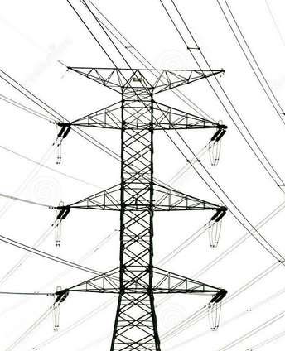
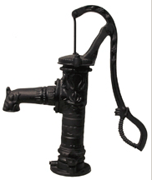
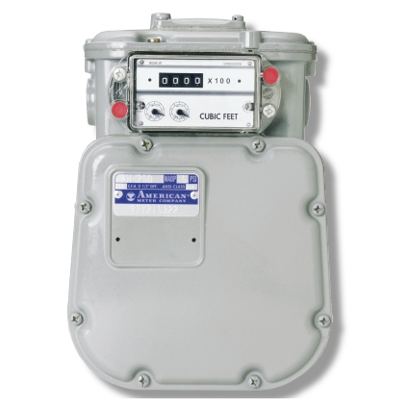

Slide 13
Applications
Traffic systems:
Roads or others
(Google Maps and many others).
Shortest route from one town to another?

Slide 14
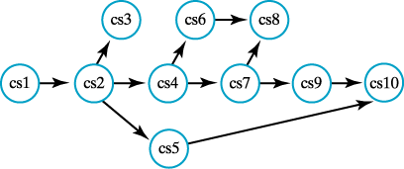
Applications
Course prerequisites

Slide 15
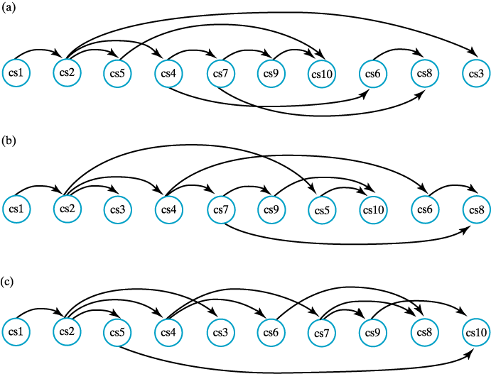
Applications – Topological Order
Maintain precedence (e1 before e2) in all cases
Possible with a directed, acyclic graph

Slide 16

Applications
Maintain precedence (e1 before e2) in all cases
Possible with a directed, acyclic graph
This is a cyclic graph, and we have a problem.
Must take cs20 before cs30
Can’t take cs20 before cs30, as
Must take cs30 before cs20 (cycle)
Can’t maintain precedence in all cases

Slide 17
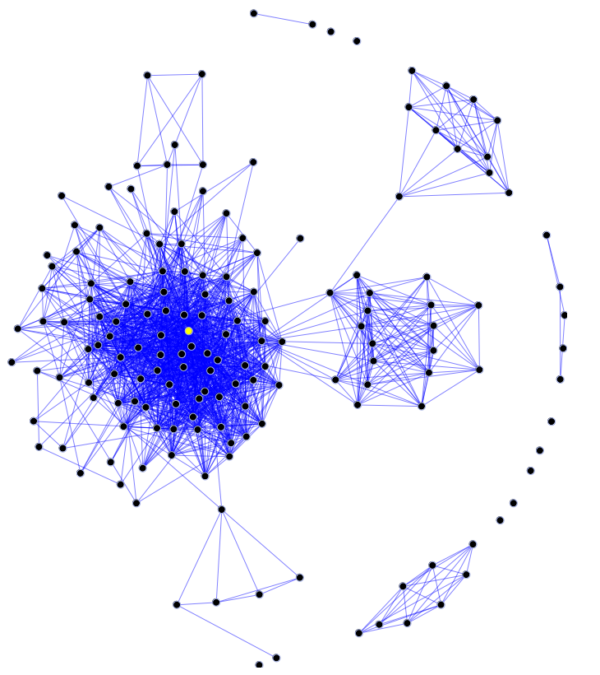
Social Networks
From Wikipedia:
A drawing of a graph in which each person is represented by a vertex and the friendship relationship is represented by an edge

Slide 18
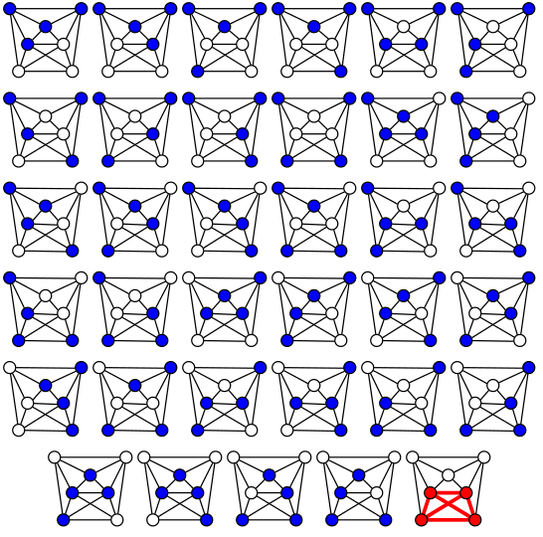
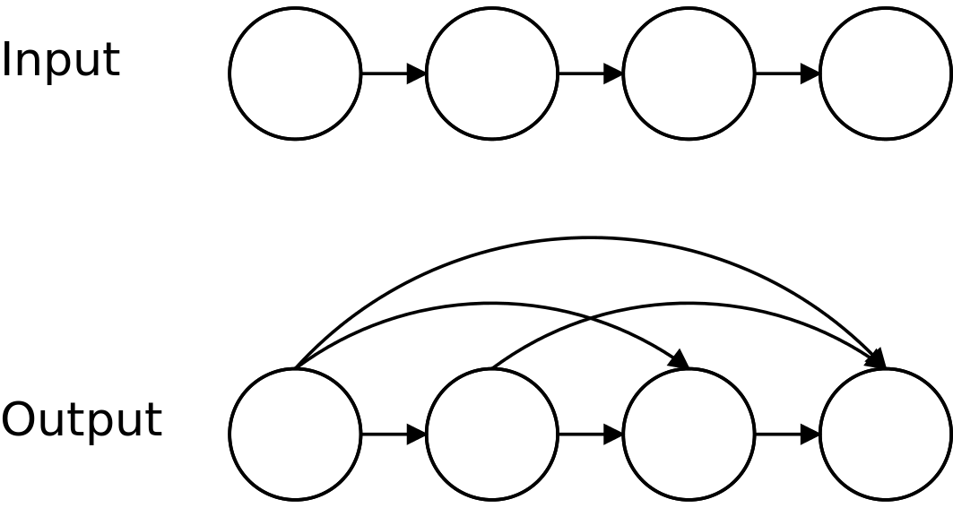
Classic Problems
Seven bridges of Königsberg http://en.wikipedia.org/wiki/Seven_Bridges_of_K%C3%B6nigsberg
Four-Colour-Problem
Travelling Salesman Problem
Clique Problem (complete subgraph)
Transitive Closure (reachability)
and many, many others...

Slide 19
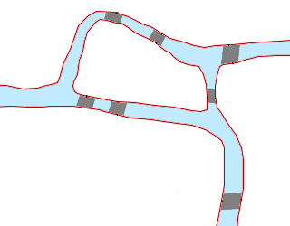
Seven Bridges of Königsberg
Königsberg in East-Prussia
(now Kaliningrad)
Leonhard Euler, 1736:
Is it possible to take a walk in Königsberg crossing every bridge exactly once?

Slide 20
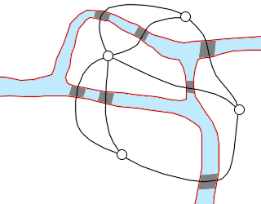
Bridges of Königsberg
Euler gave the problem a
graph theoretical formulation:
There exists an Euler-path, if
there are 0 or 2 vertices of odd degree.
If there are 2 vertices of odd degree, then the path will start at one of them and end at the other.

Slide 21
Four-color problem
How many different colors are sufficient to color the countries on a map in such a way that no two adjacent countries have the same color?
Given a planar graph, can you color the vertices so that no adjacent vertices have the same color, if you use at most four colors?
Problem difficult to prove, but the answer is yes.

Slide 22
Travelling salesman problem
A Hamilton path begins at a vertex v, passes through every vertex exactly once, and terminates at v.
Does a Hamilton circuit exist in a given graph?
variation
Given a list of cities and the distances between each pair of cities, what is the shortest possible route that visits each city exactly once and returns to the origin city?
It is an NP-hard problem in combinatorial optimization, important in operations research and theoretical computer science.

Slide 23
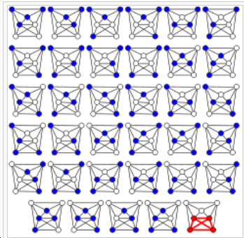
Clique Problem
From http://en.wikipedia.org/wiki/Clique_problem
In computer science, the clique problem refers to any of the problems related to finding particular complete subgraphs ("cliques") in a graph, i.e., sets of elements where each pair of elements is connected.
For example, the maximum clique problem arises in the following real-world setting. Consider a social network, where the graph’s vertices represent people, and the graph’s edges represent mutual acquaintance. To find a largest subset of people who all know each other, one can systematically inspect all subsets, a process that is too time-consuming to be practical for social networks comprising more than a few dozen people.

Slide 24
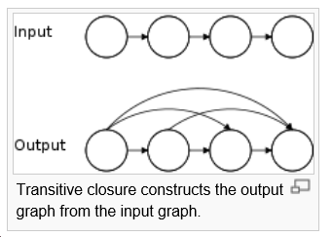
Transitive Closure
From http://en.wikipedia.org/wiki/Transitive_closure
In computer science, the concept of transitive closure can be thought of as constructing a data structure that makes it possible to answer reachability questions. That is, can one get from node a to node d in one or more hops? A binary relation tells you only that node a is connected to node b, and that node b is connected to node c, etc. After the transitive closure is constructed, as depicted in the figure, in an O(1) operation one may determine that node d is reachable from node a.

Slide 25
Modern Problems
Register allocation (graph-colouring)
Optimisation (travelling salesman + others)
Scheduling
Shortest path
www.krak.dk or http://maps.google.com/
Routing on the Internet
...
Garbage collection, method dispatching
and many, many, many, many others

Slide 26
Graph as an ADT - operations
create()
boolean isEmpty()
For Vertex and Edge
add()
remove()
retrieve() & update()
boolean hasEdge(v1, v2)
List<Vertex> getAdjacenciesTo(v)
find path
…and many more.

Slide 27
Representations
Given a graph G of n nodes
Use a list of vertices and one of the following options:
Adjacency-matrix: A N x N array. True/false or a weight indicating if to vertices are adjacent or not
Adjacency-list: n linked lists, one for each vertex. The linked list belonging to a vertex holds references to the adjacent vertices.

Slide 28
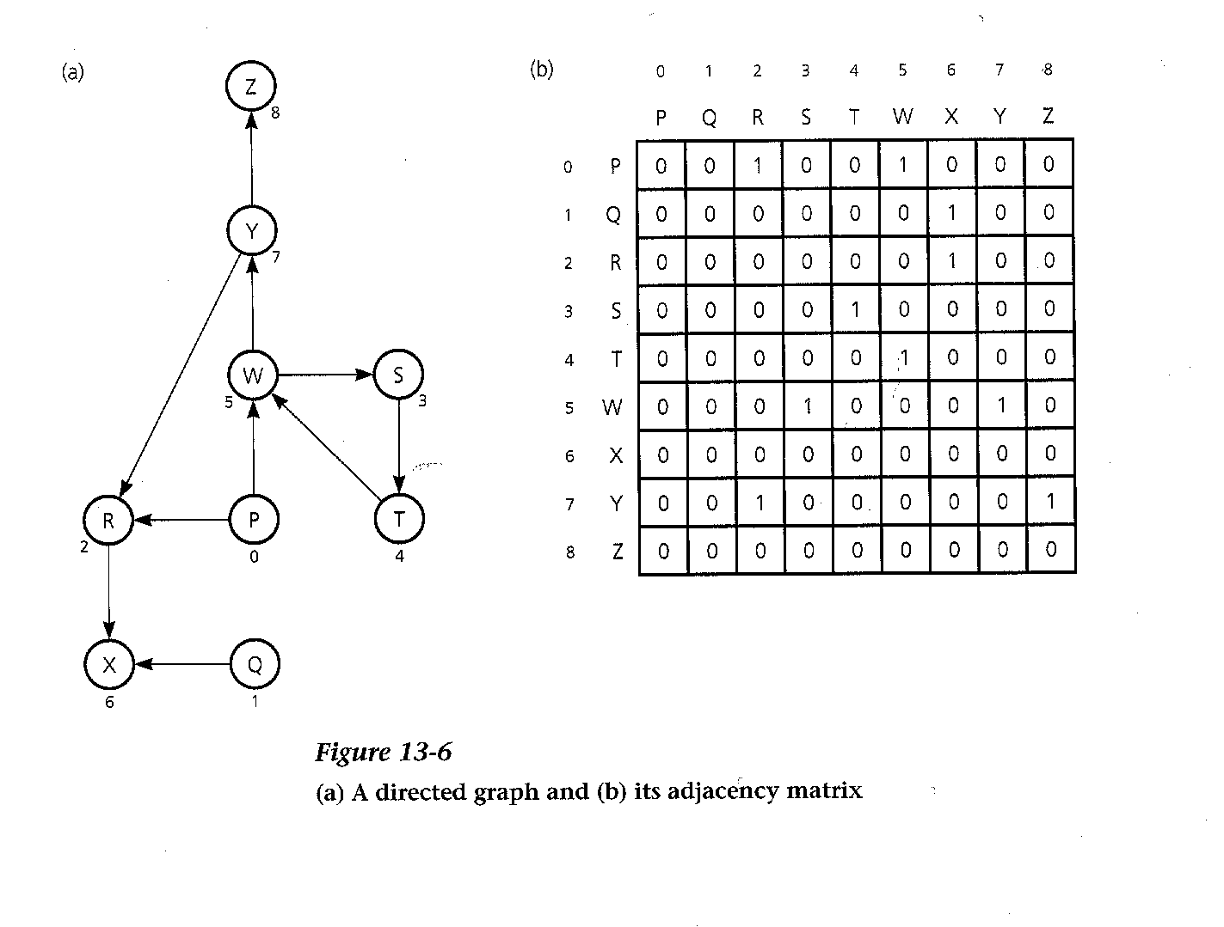
Adjacency-Matrix

Slide 29
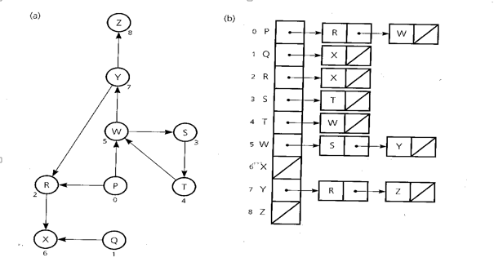
Adjacency-List
Figure 14.8

Slide 30
Comparison
Does an edge exists between two vertices?
Successors
Predecessors

Slide 31
A Note on Choosing Representation
Frequent operations:
Are two vertices adjacent?
Get all vertices adjacent to a given vertex
Heuristics:
Sparse graph (e close to n) => adjacency-list
Dense graph (e close to n²) => adjacency-matrix
Biased distribution of the frequency of operations (hasEdge and getAdjacenciesTo) may change these rules of thumb.

Slide 32
Exercise
Exercise1, A – B
Exercise2

Slide 33
Traversing Graphs
Two Algorithmic Patterns:
Depth-first: go as far away as possible and then backtrack
Breadth-first: visit all adjacent vertices before moving on to the next level
In both cases one must keep track of which vertices have been visited

Slide 34
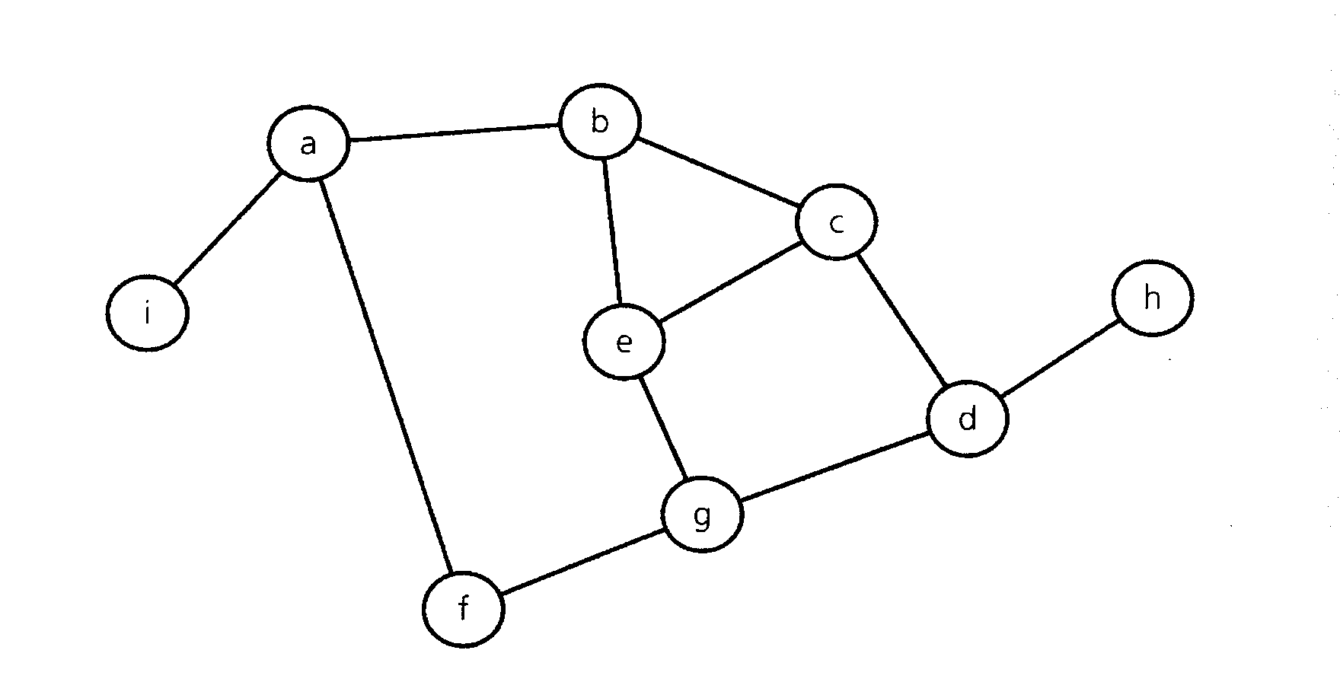
Sample Graph

Slide 35
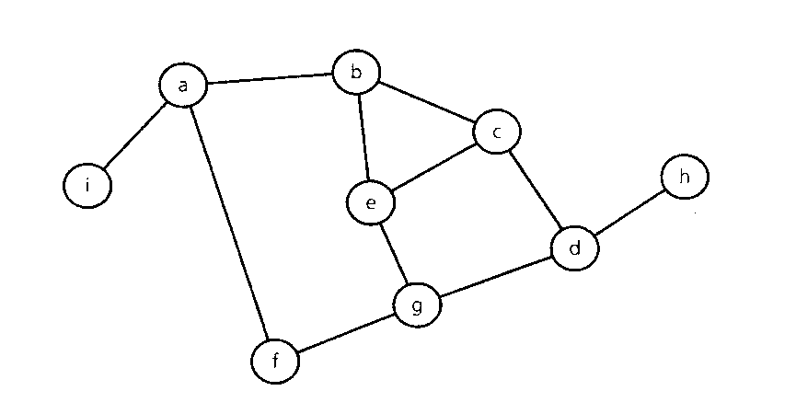
Depth-First-Search
+dfs (in v:Vertex)
// Traverses a graph beginning at vertex v by
// using a depth-first search: recursive
Mark v as visited
for (each unvisited vertex u adjacent to v)
dfs(u)

Slide 36
Breath-First-Search
+bfs (in v:Vertex)
// Traverses a graph beginning at vertex v by
// using a breadth-first search: iterative
q.createQueue()
q.enqueue(v)
Mark v as visited
while(!q.isEmpty()) {
w= q.dequeue()
//loop invariant: there is a path from
//vertex w to every vertex in the queue q
for (each unvisited vertex u adjacent to w) {
Mark u as visited
q.enqueue(u)
}// end for
} // end while

Slide 37
Important Observations
Breadth-first Queue
Depth-first Stack
Apart from that the algorithms are alike.
Implicit in the recursive version

Slide 38
Trees
All trees are graphs
But not all graphs are trees
A tree is a connected graph without cycles
Traversals:
Pre-order, in-order and post-order traversals are examples of depth-first traversal
Level-order traversal of a tree is an example of breadth-first traversal

Slide 39
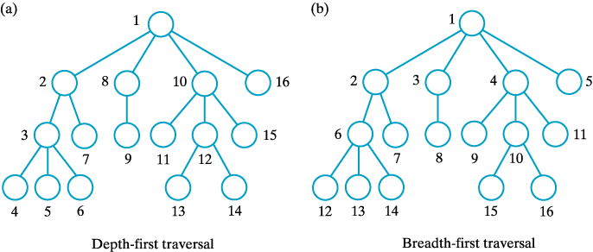
Trees
The visitation order of two traversals; (a) depth first; (b) breadth first.

Slide 40
Intended Learning Outcome (Three minutes of Reflection)
To be able to explain:
The fundamental concepts and terminology used in graph theory.
A range of different applications of graphs.
The two most common implementation of a graph and their pros and cons.
The traversal algorithms Depth First Search and Breath First Search.

Slide 41
Exercises
Exercises

